Slide 1



Automating the migration of Information Technology (IT) users of a Tech Startup from On-Premise to AWS Cloud
By Segun Ofe

Slide 2
Scenario
In the morning, the HR manager of Segmi Tech Startup sent an urgent request that 20+ IT users be migrated from On-Premise to AWS Cloud before the end of the working day. As a Cloud Infrastructure Engineer, how can you achieve this?
By Segun Ofe

Slide 3

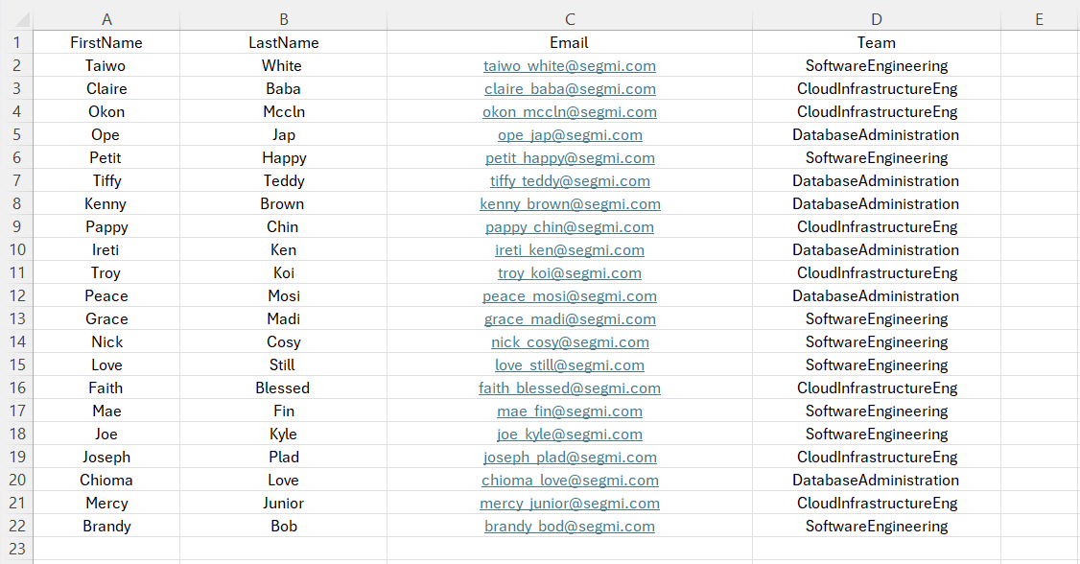

Slide 4
Two Methods
Manually adding each user to AWS Cloud using AWS Management Console
Automating the process of adding users using script from AWS Cloud Shell.
By Segun Ofe

Slide 5



Solution Architecture
Identity and Access Management (IAM)
Traditional Data Center
User Groups
+
Attach policies
User
IT Users
By Segun Ofe

Slide 6
Basic Steps
Create user groups (teams) in AWS Cloud
Import the data to AWS Cloud Shell
Run the script for automation the migration of the users to AWS Cloud
.
By Segun Ofe

Slide 7
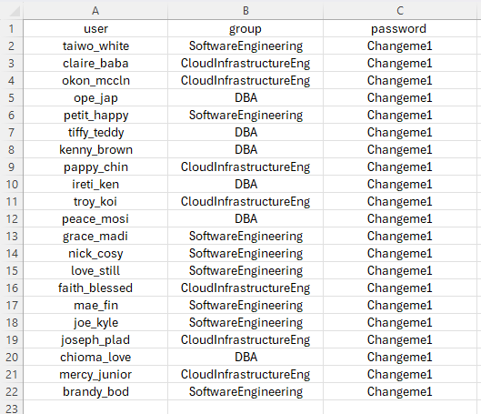

Slide 8
References
The automation script used for this project was from The Cloud Bootcamp

Slide 11
Impeccable qualities in true friends
Faith and Favor Displayed
The request of faith: “Prove thy servants, I beseech thee, ten days and let them give us pulse to eat, and water to drink” Daniel 1:12.
Be specific in your request both to man and God.
“Faith honors God and God honors faith” (Marcus Lamb).
The resolve of faith:
The daily provision of the king’s delicacy posed a daily challenge to their conviction.
For three years in training, they kept on keeping on and choose to express faith despite uncertainty.
They had a trusting disposition and stood by their biblical convictions like did others in the scriptures (Jeremiah 35:1-14; Hebrews 11:24-26).
They were not the only king’s seed brought from Jerusalem but despite what others did, they daily trusted God not to defile themselves. They daily took up their cross to remain steadfast in faith. Just like Joseph who was daily tempted by Potiphar’s wife, believers’ temptation is daily.
The result of faith:
The expression of their faith in God through request and resoluteness brought them favor before men-the prince of the eunuch and the kings (Proverb 3:4).
No matter how close you are or favored by the kings of the earth, if you lack the favor of the King of Heaven, you will soon be run out of favor with men or be disappointed (Daniel 6:14,16,18, Proverbs 31:30).

Slide 12
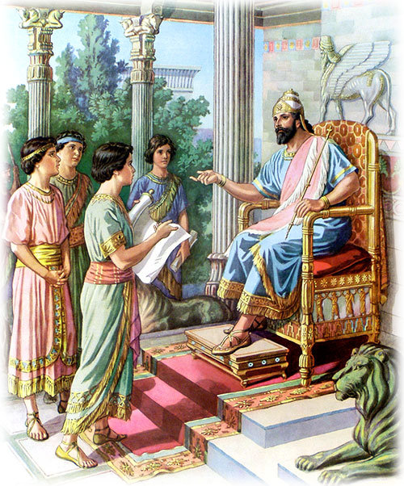
He utilized his gifts and highly placed position to witness to the prominent personalities (the kings) in the kingdom. To Nebuchadnezzar, he said “break off thy sins by doing righteous” (Daniel 4:27) and to Belshazzar, “And thou his son, O Belshazzar, hast not humbled thine heart, though thou knewest all this” (Daniel 5:22), “Thou has not glorified God O king” (Daniel 5:23). Use your gifts and opportunities to preach the gospel.
No doubt, he was fruitful in soul winning even in a strange land. Nebuchadnezzar, that proud and furious king, after experiencing humiliation from the King of all kings humbly declared “Now I Nebuchadnezzar praise and extol and honor the King of heaven, all whose works are truth, and his ways judgment: and those that walk in pride he is able to abase” (Daniel 4:37). He might be in heaven today, who knows?
What about Darius? “Now the king spake and said unto Daniel, thy God whom thou servest continually, he WILL deliver thee” (Daniel 6:16). Darius had come into faith in the living God of Daniel.

Slide 13
Conclusion
A Jonadab or a Jonathan: Do you know that friends impact more than blood-relations (Proverbs 18:24)?
Amnon’s friend (Jonadab) counseled him to commit incest which led to his future destruction while David’s friend (Jonathan) was committed to him to the fulfilment of his destiny (2 Samuel 13:3-6, 28-29, 1 Samuel 20:4,16-18,33).
Do I possess the virtues I desire in a friend (a Jonathan or a Jonadab)?
Am I the friend others will want to choose?
Does he share the same faith as I do (not just that we attend the same church-2 Peter 1:1)?
Does he love and strive for excellence, or he loves shortcuts?
As you consider choosing a friend or establishing a friendship, please be careful to ask and answer these questions.

Slide 14
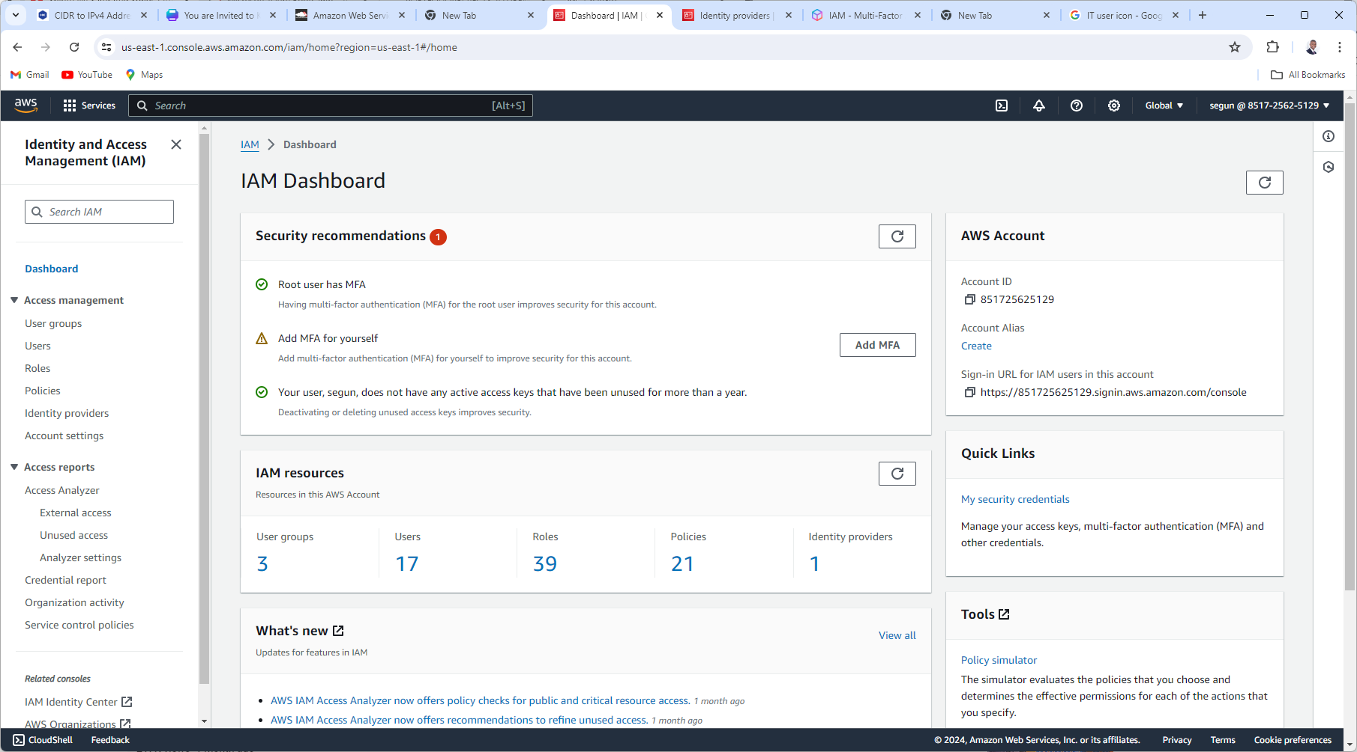

Slide 15
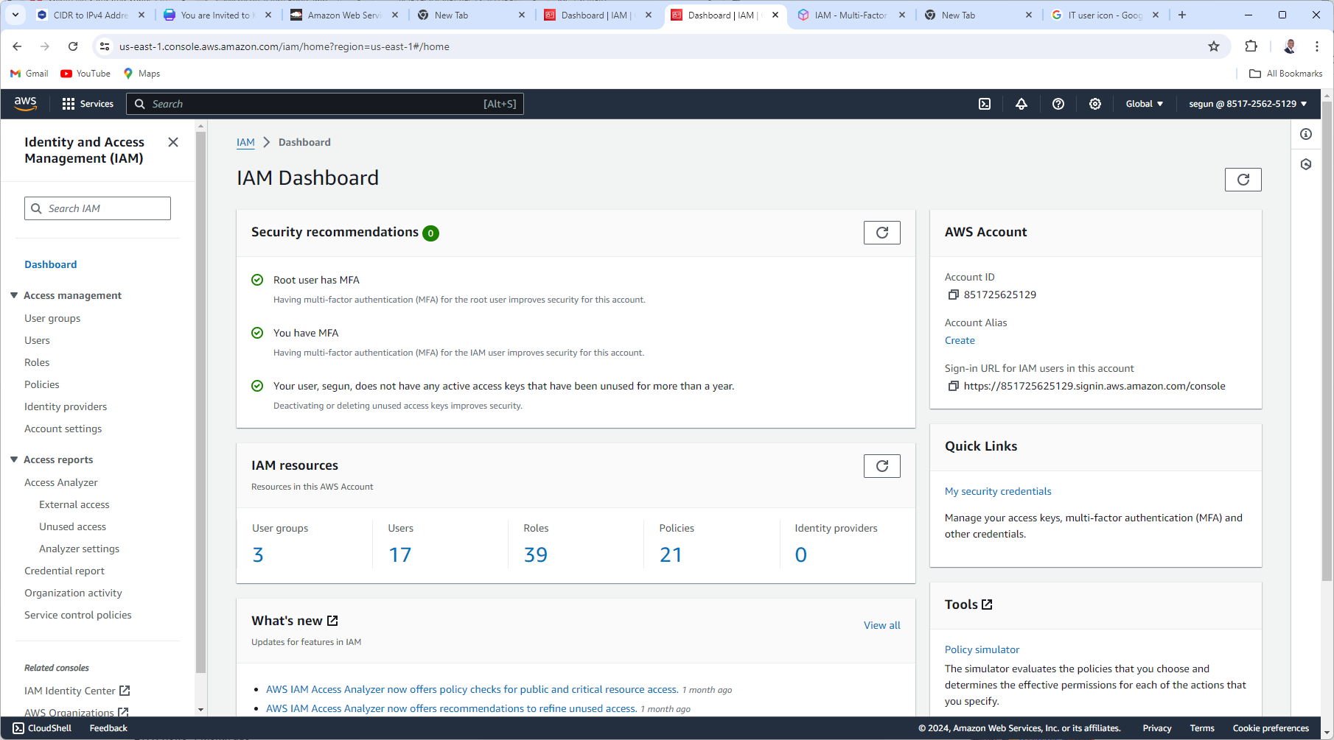

Slide 16
Solution Architecture
Identity and Access Management (IAM)
Traditional Data Center
User Groups
+
Attach policies
User
+
MFA
IT Users
By Segun Ofe

